Slide 1

PYTHON FUNDAMENTALS FOR DATA SCIENCE

Slide 2
Python Indentation
Where in other programming languages the indentation in code is for readability only, the indentation in Python is very important.
Python uses indentation to indicate a block of code.
e.g
if 5 > 2: print("Five is greater than two!")

Slide 3
Python Variables
Variables are containers for storing data values.
Python has no command for declaring a variable.
A variable is created the moment you first assign a value to it.
Casting
Names (PEP8)
Multiple values (equal signs, tuple unpacking)
Global
Notes:
Python Enhancement Proposal

Slide 4
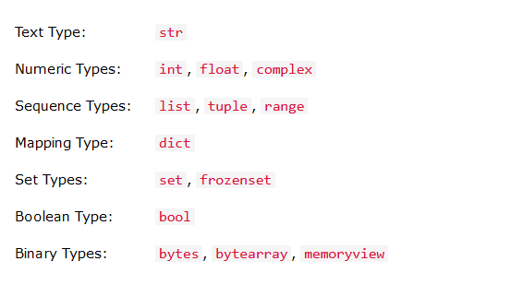
Python Data Types
Notes:
String slicing([:4]), modify(upper, lower, strip, concatenate, format, escape, methods

Slide 5
Python Operators
Arithmetic operators ( +, -, *, /, %, //(floor))
Assignment operators ( =, +=, -=, *=, /=, %=, //=, **=,)
Comparison operators ( ==, <=, >=, !=, <, >)
Logical operators ( and, or, not )
Identity operators ( is, is not)
Membership operators ( in, not in)
Bitwise operators (read on your own)

Slide 6
Python Lists
Lists are used to store multiple items in a single variable.
List items are ordered, changeable, and allow duplicate values.
Length of the list.
Supports multiple data types.
Use [] or list() constructor to create a list.
Use indexes to access list items.
Negative indexing means start from the end.
List slicing

Slide 7
Lists cont’d
Change list items (use item index)
Add list items (use append list method)
Use (insert) to add an item to a specific index
Remove a list item by name use remove()
Remove a list item by index (pop) or del list[index]
Delete an entire list (del list_name) or list_name.clear()
Loop through lists (for, for in range, while)
Notes:
Calling pop() without an index removes the last item in the list

Slide 8
List Comprehension
List comprehension offers a shorter syntax when you want to create a new list based on the values of an existing list.
newlist = [expression for item in list]
newlist = [expression for item in list if condition == True]
newlist = [x if x != item_a else item_b for x in list]
Sort lists (list.sort() #asc, list.sort(reverse=True) #desc)

Slide 9
Python Tuples
A tuple is a collection which is ordered and unchangeable.
Tuple items are ordered, unchangeable, and allow duplicate values.
Tuple unpacking
Looping through tuples
Join tuples

Slide 10
Python sets
A set is a collection which is unordered, unchangeable*, and unindexed.
Once a set is created, you cannot change its items, but you can add new items.
fruit_set = {"apple", "banana", "cherry"}
Add items (fruit_set .add(‘oranges’)
Concertante lists or add other iterable to a set
mylist = [“berries", “passion"]
fruit_set.update(mylist)
Notes:
Note: Sets are unordered, so you cannot be sure in which order the items will appear.
Note: Set items are unchangeable, but you can remove items and add new items.

Slide 11
Sets cont’d
Remove items ( remove, discard, clear )
Loop through sets
Join sets (union, update, intersection_update, intersection, symmetric_difference_update)

Slide 12
Python Dictionaries
Dictionaries are used to store data values in key:value pairs.
A dictionary is a collection which is ordered*, changeable and do not allow duplicates.
car_dict = { "brand": "Ford", "model": "Mustang", "year": 1964 }

Slide 13
Dictionary cont’d
Access items ([ ], get)
Keys
Values
Items (The items() method will return each item in a dictionary, as tuples in a list)
Key exists ( in operator)
Change Items
Add, change items ([ ], update)

Slide 14
Dictionary cont’d (Remove Items)
By key (dict.pop(key))
del dict[key]
dict.popitem() #removes the last inserted item in the dict
Loop through
Copy dicts (new_dict = old_dict.copy()) # not new_dict = old_dict
Dictionary comprehension
Notes:
Loop both key and value, for key, value in dict.items()
Copy using a dict() constructor

Slide 15
Conditional Structures
If ….
If …. Else …
If … Elif …. Else …

Slide 16
Loops
While condition : …
For … in … iterable
For … in range(start, stop, step) …
For …. In iterable … else …
Break
Continue
Pass

Slide 17
Functions
A function is a block of code which only runs when it is called.
def
Call
Arguments
Arbitrary Arguments, *args
Keyword Arguments
Arbitrary Keyword Arguments, **kwargs
Default Parameter Value
Return Values
Notes:
Recursion python
def tri_recursion(k): if(k > 0): result = k + tri_recursion(k - 1) print(result) else: result = 0 return result print("\n\nRecursion Example Results") tri_recursion(6)

Slide 18
Python Lambda
A lambda function is a small anonymous function.
A lambda function can take any number of arguments, but can only have one expression.
Syntax lambda arguments : expression
x = lambda a, b : a * b print(x(5, 6))
Common use cases for lambda functions
Notes:
Note: Use lambda functions when an anonymous function is required for a short period of time.

Slide 19
Math
Sqrt
Ceil
Floor
Pi

Slide 20
PIP
Install
Uninstall
list

Slide 21
Python Try Except
The try block lets you test a block of code for errors.
The except block lets you handle the error.
The else block lets you execute code when there is no error.
The finally block lets you execute code, regardless of the result of the try- and except blocks.

Slide 22
try: f = open("demofile.txt") try: f.write("Lorum Ipsum") except: print("Something went wrong when writing to the file") finally: f.close() except: print("Something went wrong when opening the file") Raise an exception raise Exception(message)

Slide 23
END

